Slide 1
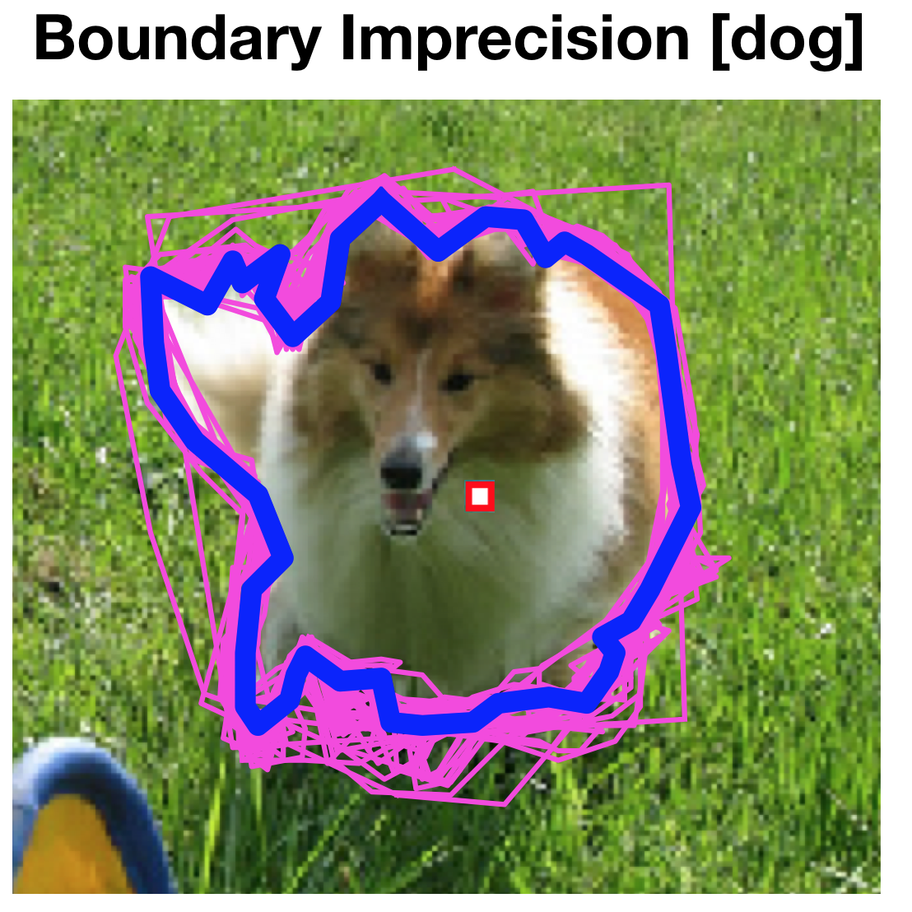
Aggregating Crowdsourced Image Segmentations
Doris Jung-Lin Lee¹, Akash Das Sarma², Aditya Parameswaran¹
¹ University of Illinois, ² Facebook Inc.
Tile-based Aggregation
Clustering Preprocessing
Results Highlights
Performance aggregation > retrieval baseline
Performance scaling as # of workers increases!
Clustering is semantically meaningful and improves algorithm performance by ≈ 5%
Expectation-Maximization
Greedy
Majority Vote
Notes:
Instance-level image segmentation provides rich information crucial for scene understanding in a variety of real-world applications. In this paper, we evaluate multiple crowdsourced algorithms for the image segmentation problem, including novel worker-aggregation-based methods and retrieval-based methods from prior work. We characterize the different types of worker errors observed in crowdsourced segmentation, and present a clustering algorithm as a preprocessing step that is able to capture and eliminate errors arising due to workers having different semantic perspectives. We demonstrate that aggregation-based algorithms attain higher accuracies than existing retrieval-based approaches, while scaling better with increasing numbers of worker segmentations. For more information, please come check out our poster tonight!

